Slide 1
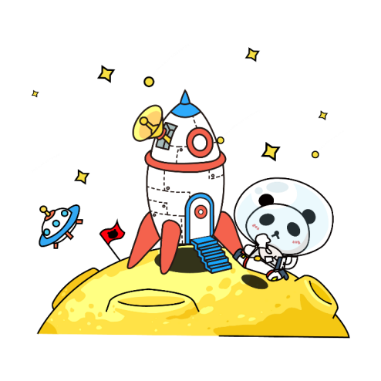
Adventure in the Three Realms
Team members：
Xu Xueqing--24517212
Li Chenyao --24516688
Han Xinyue--24516565

Slide 2

CONTENTS
01
Game Introduction
02
Understanding of UX
GitHub in a Team Environment
03
04
Feedback and Improvement
04

Slide 3

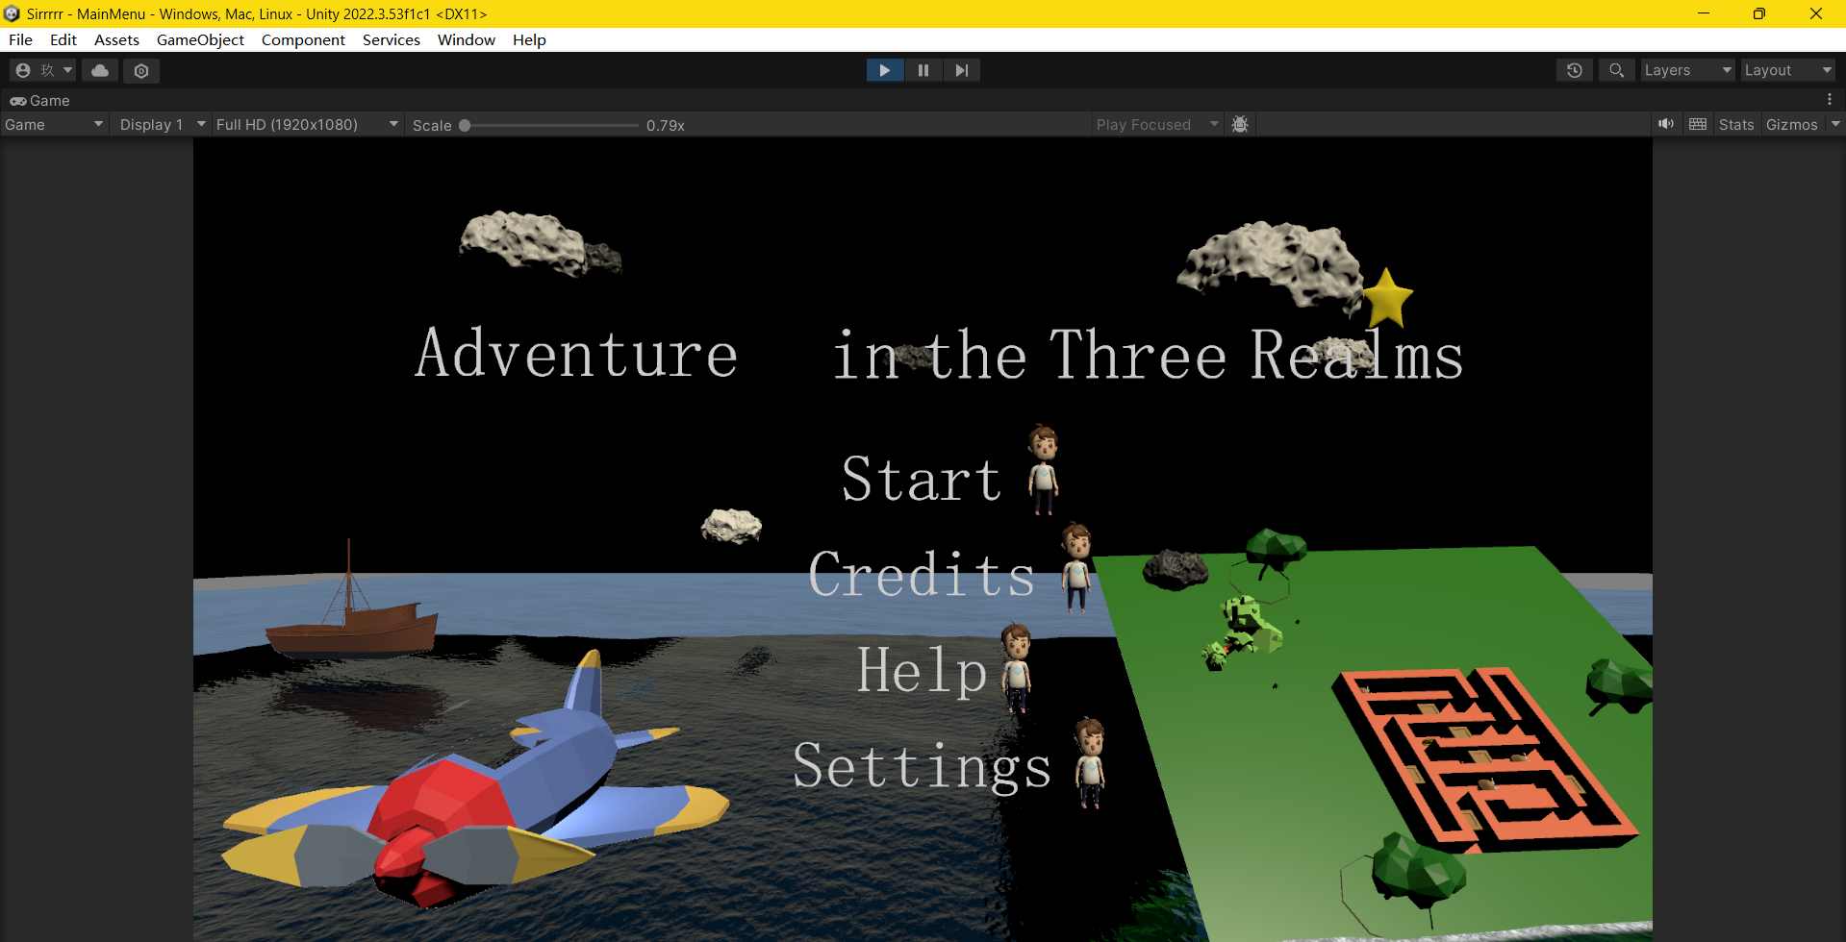
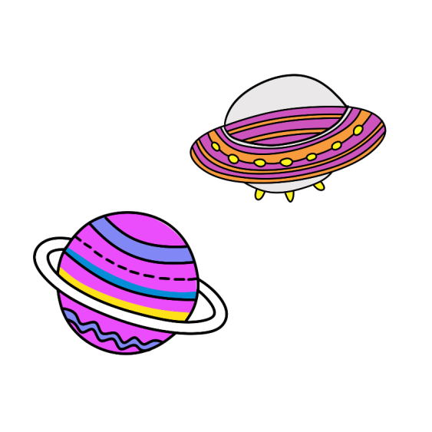
01
Game Introduction
This is the menu page of the game. Users can achieve various functions by clicking on the four buttons on the menu page. When the user clicks the "Start" button, the scene selection will be triggered. When the user clicks the "Credits" button, the score ranking list will appear. When the user clicks the "Help" button, the user feedback function will be displayed. When the user clicks the "Setting" button, the game settings page will be presented.

Slide 4
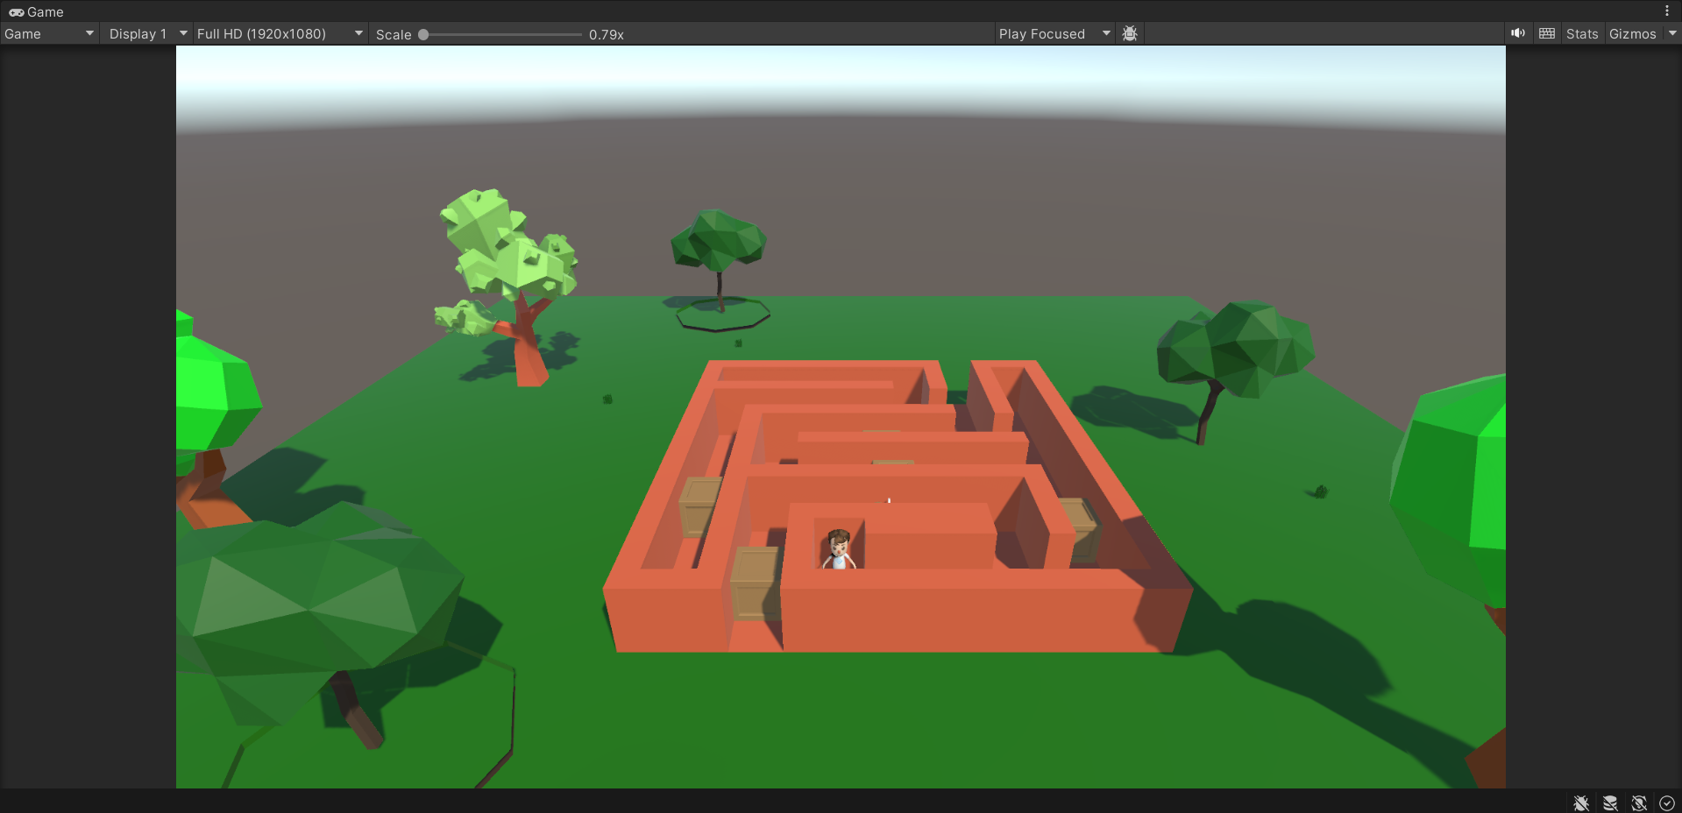

01
Game Introduction
Rule Introduction
This is a maze located in the forest. The player wins if he manages to exit the maze within the given time limit and collects all the gold coins.
Scoring Mechanism
Players pick up gold coins.
Reasons for Potential Failure
1.Exceed time limit.
2.Lose life points if hit the monsters on the road.
3.Boxes need to be moved on the road.

Slide 5
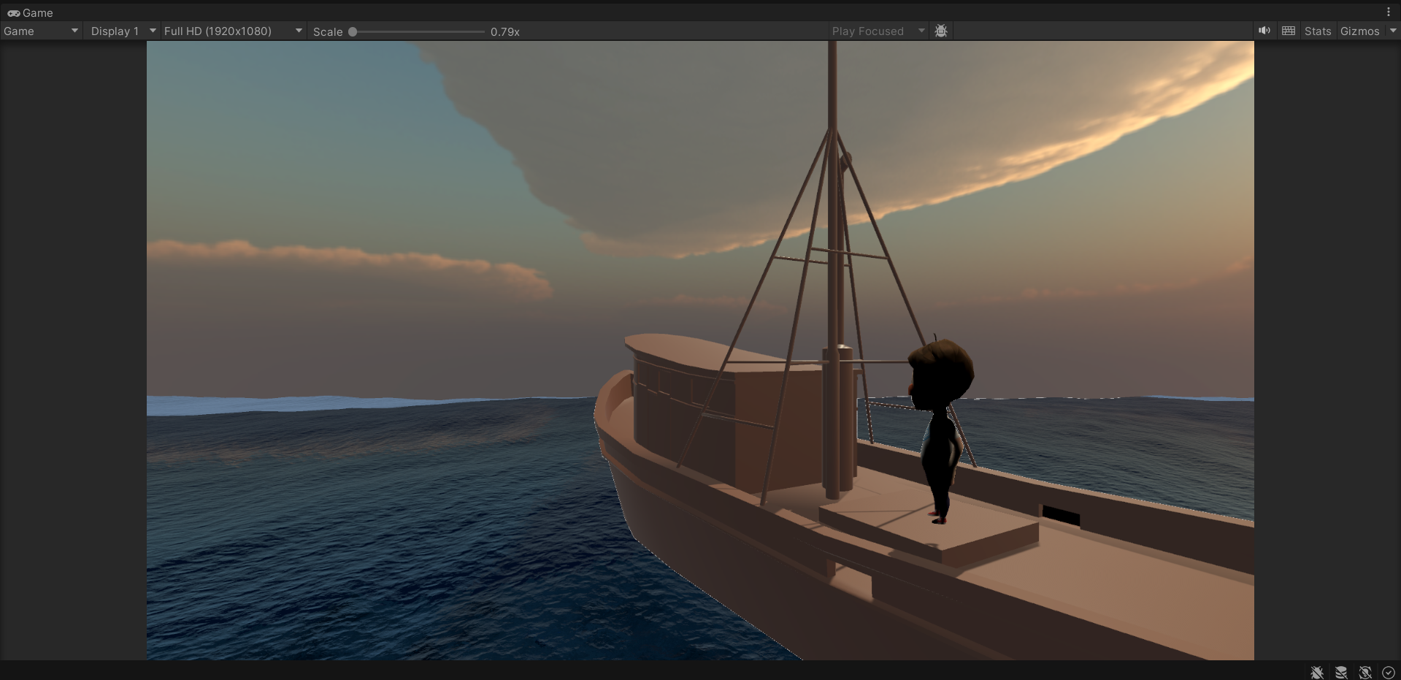
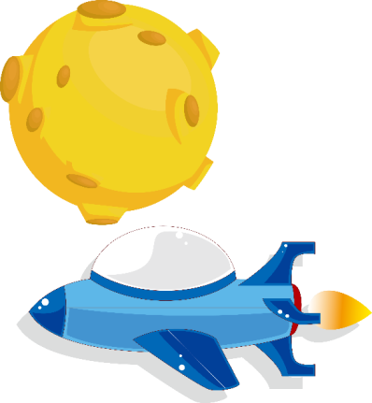
01
Game Introduction
Rule Introduction
This is a game played on the sea surface. Players need to steer the ship and retrieve the treasures hidden beneath the sea.
Scoring Mechanism
Players pick up the treasure hidden beneath the sea.
Reasons for Potential Failure
1.Players need to complete the task within the given time limit.
2.Players need to collect all the treasures in order to pass the level.

Slide 6
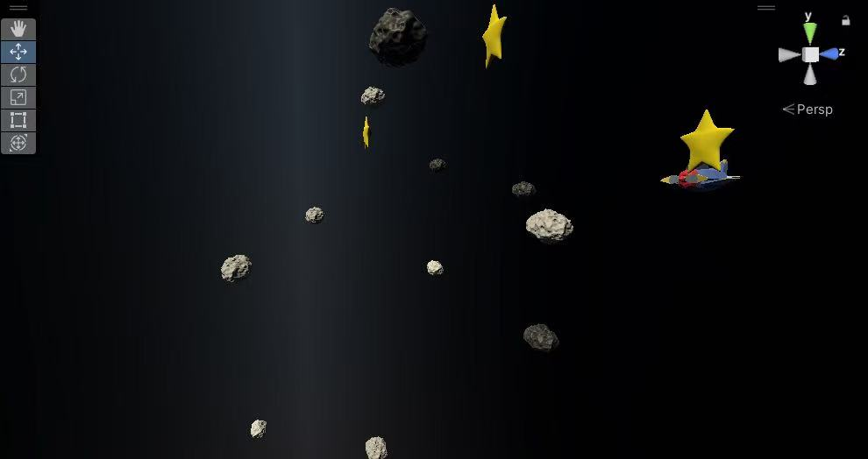

01
Game Introduction
Rule Introduction
This is a game set in space. Players need to control the spaceship to avoid meteorites and also need to collect stars.
Scoring Mechanism
Players pick up the treasure hidden beneath the sea.
Reasons for Potential Failure
1.Exceed time limit.
2.Lose life points if hit the meteorites on the road.

Slide 7
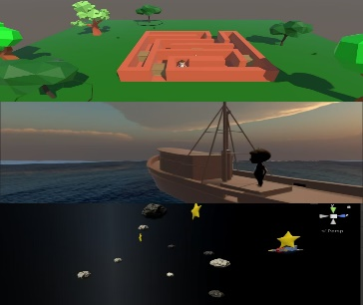
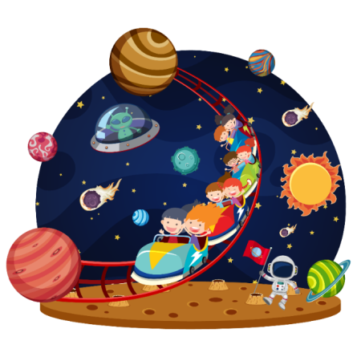
02 Understanding of UX
Consistency
Feedback mechanisms
Difficulty curve
Interface layout
音效
时间
生命
Although the three levels differ in gameplay, they share a common set of control logic. Levels use the arrow keys on the keyboard to control the player's direction. The style of the three levels is generally the same, and the font is coordinated.
All actions are fed back. In terms of sound, this can be seen when being caught by an NPC, when the robotic arm grabs treasure, when the plane hits a meteorite, and when scoring. The visual aspect is reflected in the particle effect when collecting items.
From the first level of the maze, which focuses on decryption, to the second level, the ocean theme, which focuses on rhythm control, to the third level, which focuses on space, which focuses on quick reactions, and the difficulty is gradual.
The three levels have a unified HUD layout, the health center icon is located in the upper right corner, and the countdown is located in the upper left corner of the interface. Most of the icons are common across levels.

Slide 8

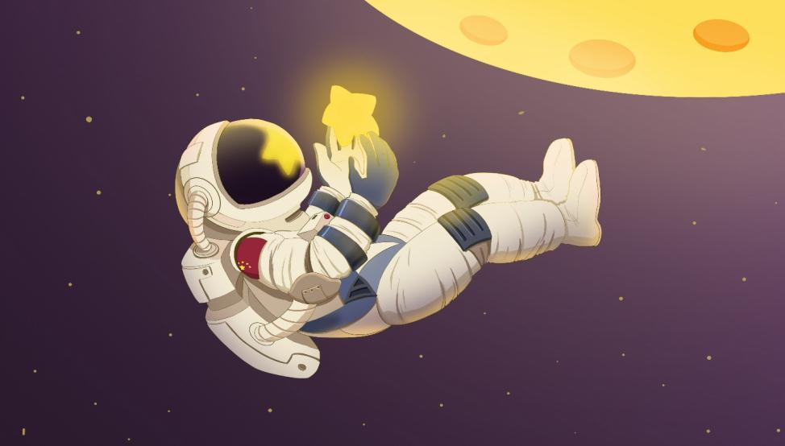

04
PLEASE FILL IN THE TITLE
请您输入标题
让孩子学习天文学可以对宇宙和世界都有客观的理解，能有效开发孩子的空间想象能力和思维拓展能力。此外，由于天文学强调客观地观察宇宙并得出客观规律，所以还蕴藏着很多孩子随时随地需要用到的物理，化学，数学以及科学小知识，可以培养孩子的科学素质

Slide 9

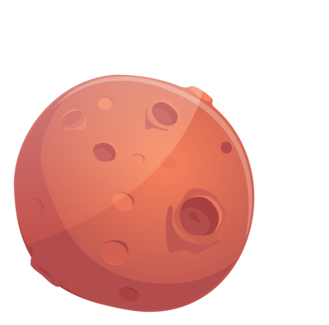
04 Reflection and improvement
Current disadvantage: The menu page considers using a spellbook theme. In the maze level, there is a delay in the sound effect when the player encounters an NPC. When the manipulator arm of the ocean level is continuously grasping, the integration system cannot respond in time. Space levels: Meteorite flight stuttering affects the player experience.
Future Directions: Adjust the style of the menu page, find more suitable spellbook materials and add page flip animations to them to make them more theme-oriented. The script that tuned the maze section causes the sound effects to appear without delay. Improve the point system of all levels, so that there can be no response to the failure of points to expire. Tweaked the meteorite movement script to make its movement smoother and enhance the player experience.

Slide 10
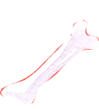


02 请你输入标题
给孩子讲物理最主要的还是得引发他们的兴趣，故事是最主要的，其次才是知识点，应当把知识点包在故事里面。“各行各业的高手都是这么做的，比如马云来给你讲一个企业管理的课，他一定是给你讲故事。”
01.ENTER YOUR TITLE
To compete in the challenging global environment, companies are changing their business processes by extending them to include other companies in the supply chain.
02.ENTER YOUR TITLE
To compete in the challenging global environment, companies are changing their business processes by extending them to include other companies in the supply chain.
ENTER YOUR TITLE
laugh graphic design thank you for buying this template, we mainly engaged in various types of advertising graphic design.
03.ENTER YOUR TITLE
To compete in the challenging global environment, companies are changing their business processes by extending them to include other companies in the supply chain.
ENTER YOUR TITLE 此处添加详细文本描述，建议与标题相关并符合整体语言风格，语言描述尽量简洁生动。尽量将每页幻灯片的字数控制在 200字以内。

Slide 11

02 请你输入标题
对科学家来说，做科普为什么比做科研还难？
“科研，除非你做出像牛顿和爱因斯坦那样的成就，否则做一个普通科学家相对来讲，他是有程序的，就说你上完大学读研究生，读研究生然后读博士，读博士后再做几年博士后。而科普是没有章程的，就像写作一样，中文系是不培养作家的，同样理工科也不培养科普作家，科普作家要靠自己摸索，所以比较难。”李淼说。

Slide 12
03
请您输入标题
PLEASE FILL IN THE TITLE
为客户提供有效服务，是我们工作的方向和价值评价的标尺。为客户提供有效服务，是我们工作的方向和价值评价的标尺。为客户提供有效服务，是我们工作的方向和价值评价的标尺。

Slide 13
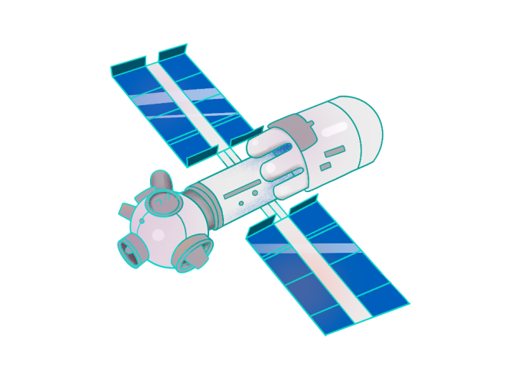

03 请你输入标题
Professional custom all kinds of industry ppt template
ENTER YOUR TITLE 此处添加详细文本描述，建议与标题相关并符合整体语言风格，语言描述尽量简洁生动。尽量将每页幻灯片的字数控制在 200字以内
ENTER YOUR TITLE 此处添加详细文本描述，建议与标题相关并符合整体语言风格，语言描述尽量简洁生动。尽量将每页幻灯片的字数控制在 200字以内。

Slide 14

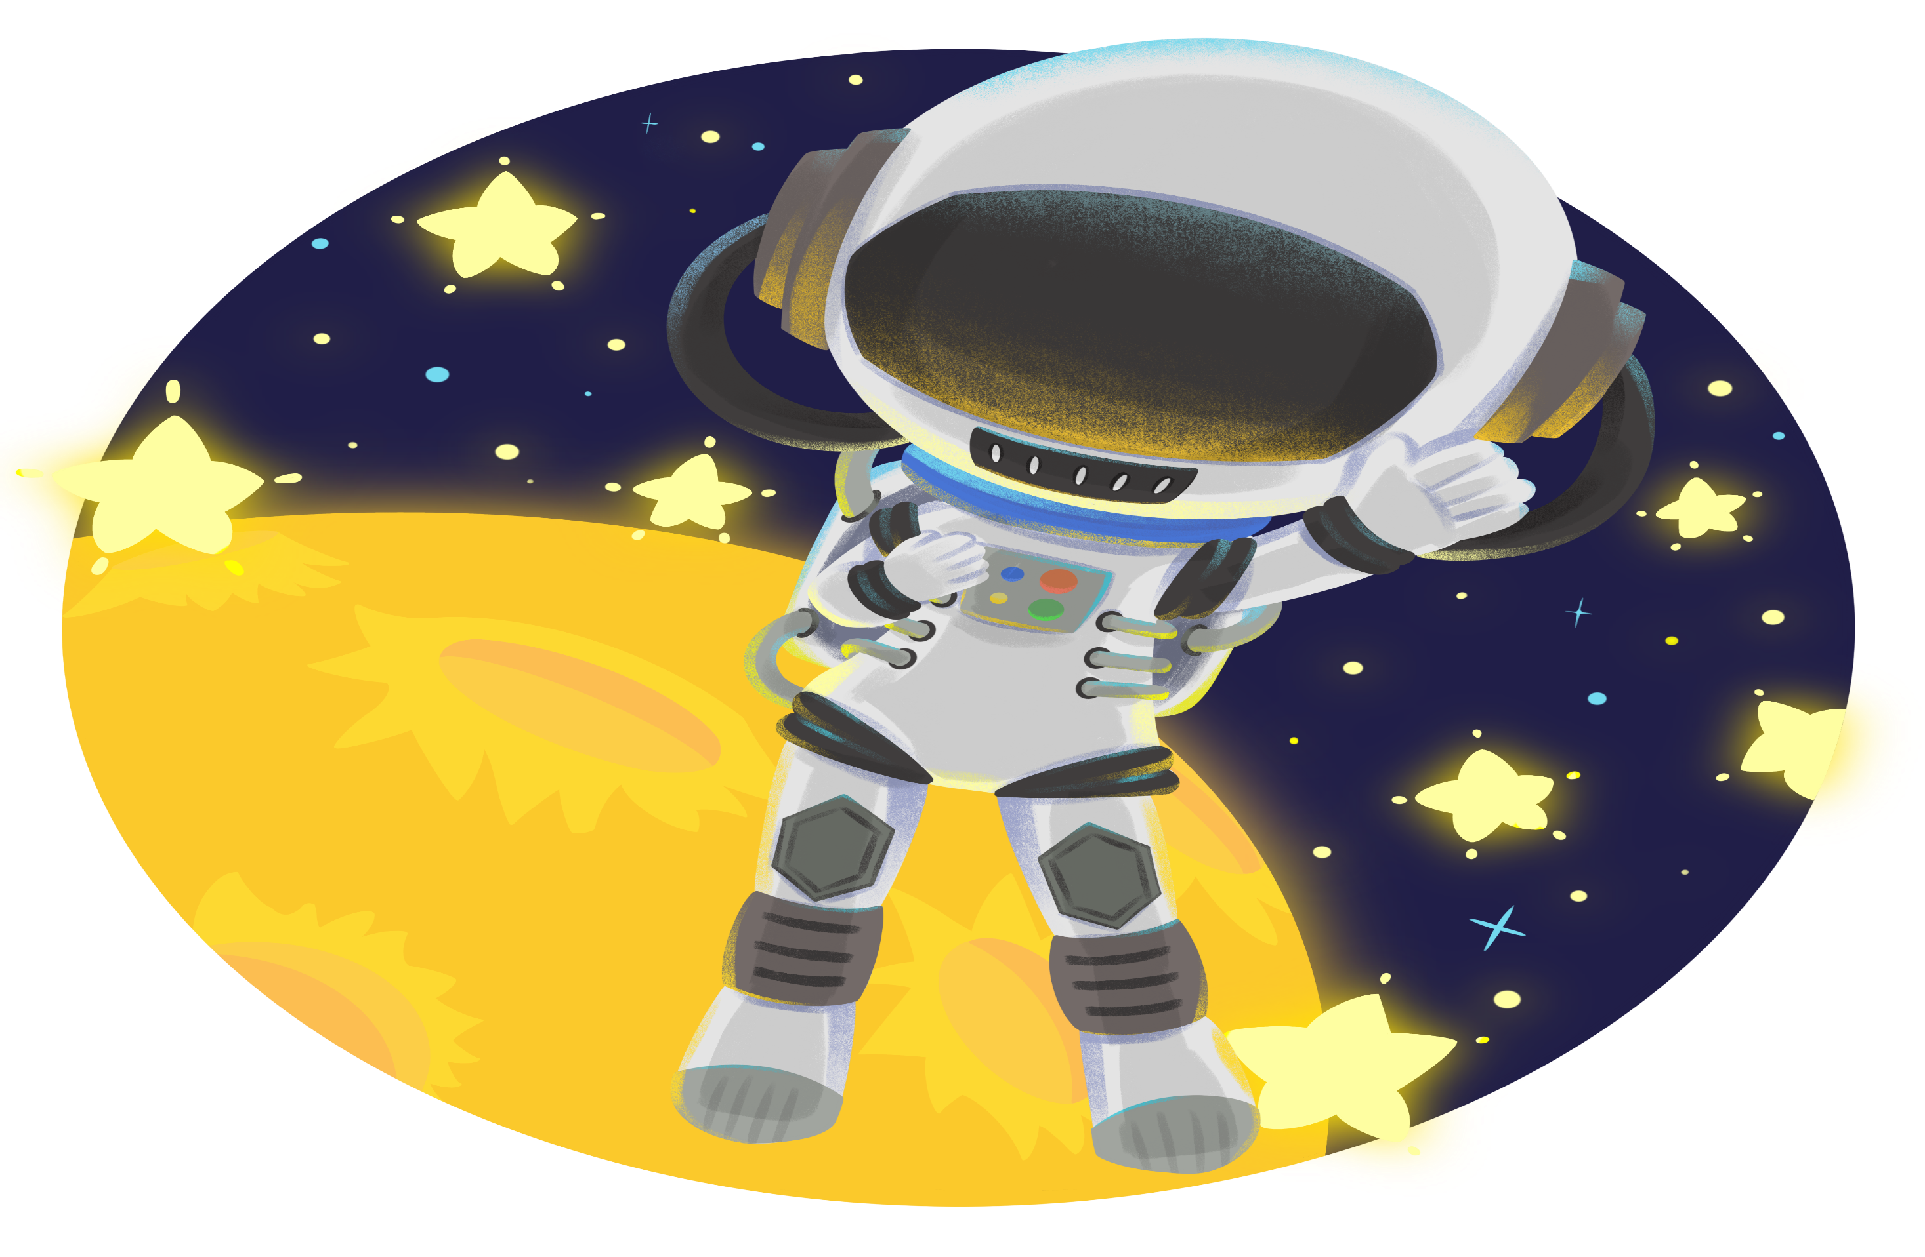


03 请你输入标题
laugh graphic design thank you for buying this template, we mainly engaged in various types of advertising graphic design.
laugh graphic design thank you for buying this template, we mainly engaged in various types of advertising graphic design.
laugh graphic design thank you for buying this template, we mainly engaged in various types of advertising graphic design.
laugh graphic design thank you for buying this template, we mainly engaged in various types of advertising graphic design.
YOUR TITLE
YOUR TITLE
YOUR TITLE
YOUR TITLE

Slide 15

03 请你输入标题
探索宇宙还会给我们带来一些实际的好处，就是让我们保持把眼光放远的态度。孩子总是把身边一点小事儿当成天大的事儿，或者以为自己是世界的中心。
BEGIN THE LABOR OF A NEW DAY

Slide 16
04
PLEASE FILL IN THE TITLE
请您输入标题
为客户提供有效服务，是我们工作的方向和价值评价的标尺。为客户提供有效服务，是我们工作的方向和价值评价的标尺。为客户提供有效服务，是我们工作的方向和价值评价的标尺。

Slide 17
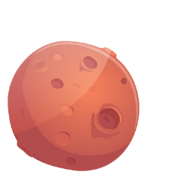




04 请你输入标题
laugh graphic design thank you for buying this template, we mainly engaged in various types of advertising graphic design.
laugh graphic design thank you for buying this template, we mainly engaged in various types of advertising graphic design.
laugh graphic design thank you for buying this template, we mainly engaged in various types of advertising graphic design.
ENTER YOUR TITLE
ENTER YOUR TITLE
ENTER YOUR TITLE

Slide 18

04 请你输入标题
laugh graphic design thank you for buying this template, we mainly engaged in various types of advertising graphic design.
为客户提供有效服务，是我们工作的方向和价值评价的标尺。为客户提供有效服务，是我们工作的方向和价值评价的标尺。为客户提供有效服务，是我们工作的方向和价值评价的标尺。
laugh graphic design thank you for buying this template, we mainly engaged in various types of advertising graphic design.

Slide 19


感谢聆听
感谢聆听
科学的永恒性就在于坚持不懈地寻求之中，科学就其容量而言，是不枯竭的，就其目标而言，是永远不可企及的。——卡·冯·伯尔

Slide 20

可以在下列情况使用
个人学习、研究。
拷贝模板中的内容用于其它幻灯片母版中使用。
不可以在以下情况使用
任何形式的在线付费下载。
网络转载、线上线下传播。
PPT模板： www.1ppt.com/moban/ 行业PPT模板：www.1ppt.com/hangye/
节日PPT模板：www.1ppt.com/jieri/ PPT素材： www.1ppt.com/sucai/
PPT背景图片：www.1ppt.com/beijing/ PPT图表： www.1ppt.com/tubiao/
优秀PPT下载：www.1ppt.com/xiazai/ PPT教程： www.1ppt.com/powerpoint/
Word模板： www.1ppt.com/word/ Excel模板： www.1ppt.com/excel/
个人简历： www.1ppt.com/jianli/ PPT课件： www.1ppt.com/kejian/
手抄报： www.1ppt.com/shouchaobao/ 试题下载： www.1ppt.com/shiti/
教案下载： www.1ppt.com/jiaoan/ 字体下载： www.1ppt.com/ziti/

